Slide 1
“Inter-Inter-Coder” Analysis: A Multiset Approach for LLM Evaluation in Public Safety Analytics
Nathan J. Elrod, M.A, M.S.I.T
College of Arts & Sciences
University of Cincinnati
elrodnj@ucmail.uc.edu
ORCID: 0000-0002-6949-3689
Jess Kropczynski, PhD
School of Information Technology
University of Cincinnati
kropczjn@ucmail.uc.du
ORCID: 0000-0002-7458-6003
Rob Grace, PhD
School of Information Technology
University of Cincinnati
gracewr@ucmail.uc.edu
ORCID: 0000-0001-6517-6806
Notes:
Hi, my name is Nate, and I’m here representing the University of Cincinnati School of Information Technology and the UC Civic Tech Lab. I’ also the Director of Enrollment at the UC College of Arts & Sciences
This study is called “Inter-Inter-Coder Analysis”
Written with my collaborators doctors Jess Kropczynski and Rob Grace

Slide 2
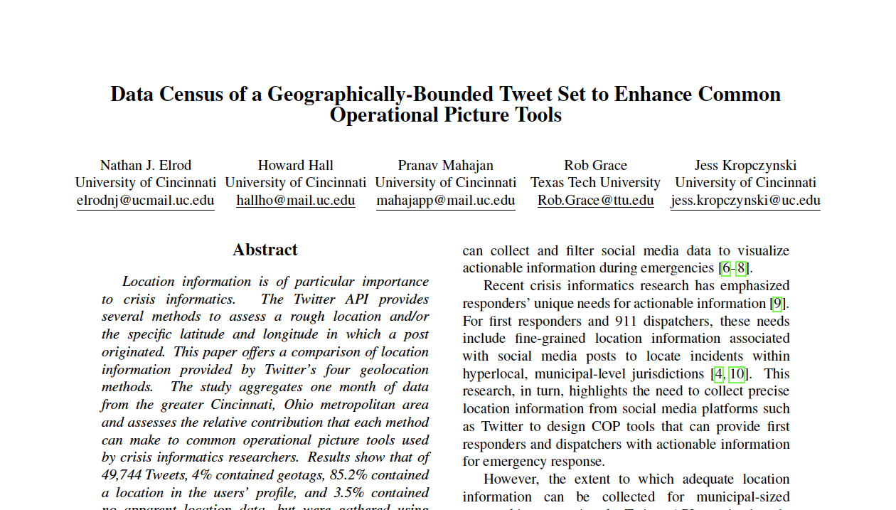

BACKGROUND
Elrod, N.; Hall, H.; Mahajan, P.; Grace, R.; Kropczynski, J. (2021). Data census of a geographically-bounded tweet set to enhance common operational picture tools. Proceedings of the 54th Hawaii International Conference on System Sciences. pp. 2245-2254. https://doi.org/10.24251/hicss.2021.275
Notes:
Just a little background
This paper is the third in a series of publications that came out of the COVID-19 pandemic.
The first dealt with the acquisition and analysis of geo-relevant Twitter data

Slide 3
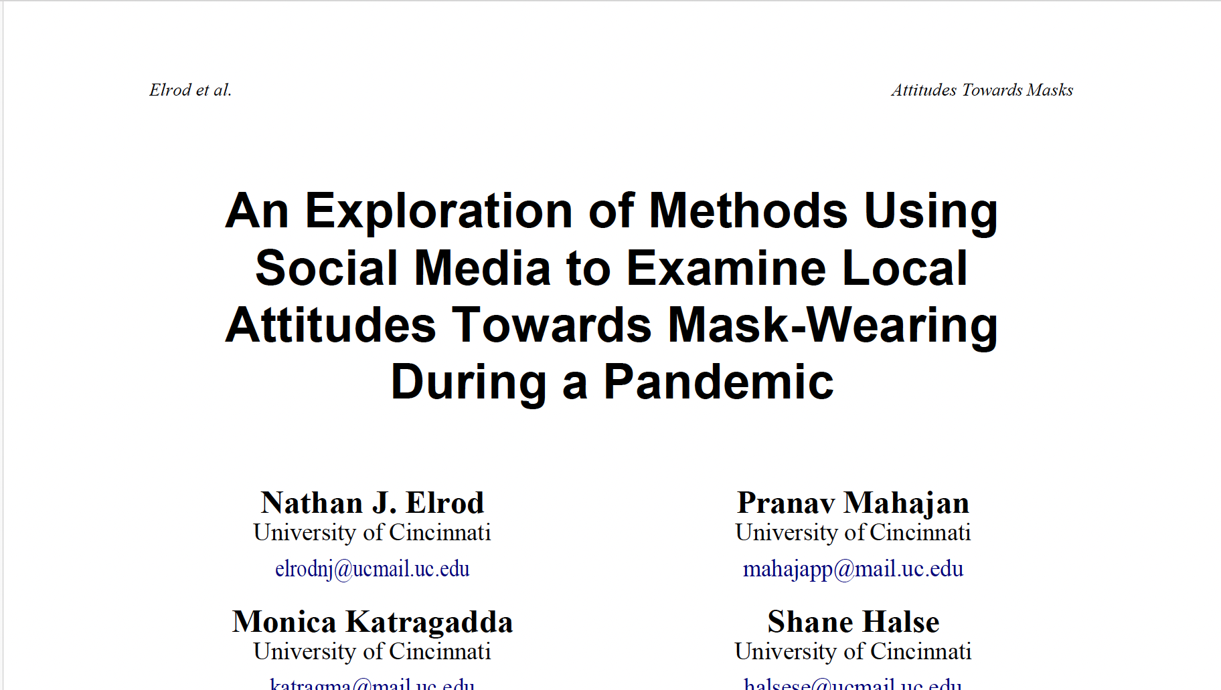

BACKGROUND
Elrod, N.; Mahajan, R.; Katragadda, M.; Halse, S.; Kropczynski, J. (2021). An Exploration of Methods Using Social Media to Examine Local Attitudes Towards Mask-Wearing During a Pandemic. (WiP) Disaster Public Health & Healthcare Informatics in the Pandemic Proceedings of the 18th ISCRAM Conference. pp. 345-358. https://idl.iscram.org/show.php?record=2338
Notes:
The second paper was submitted as a work in progress
We attempted to perform sentiment analysis on the previously collected data
using various techniques
NO success
failed to correlate sentiment with human coders
And in hindsight, the intercoder analysis was messy

Slide 4
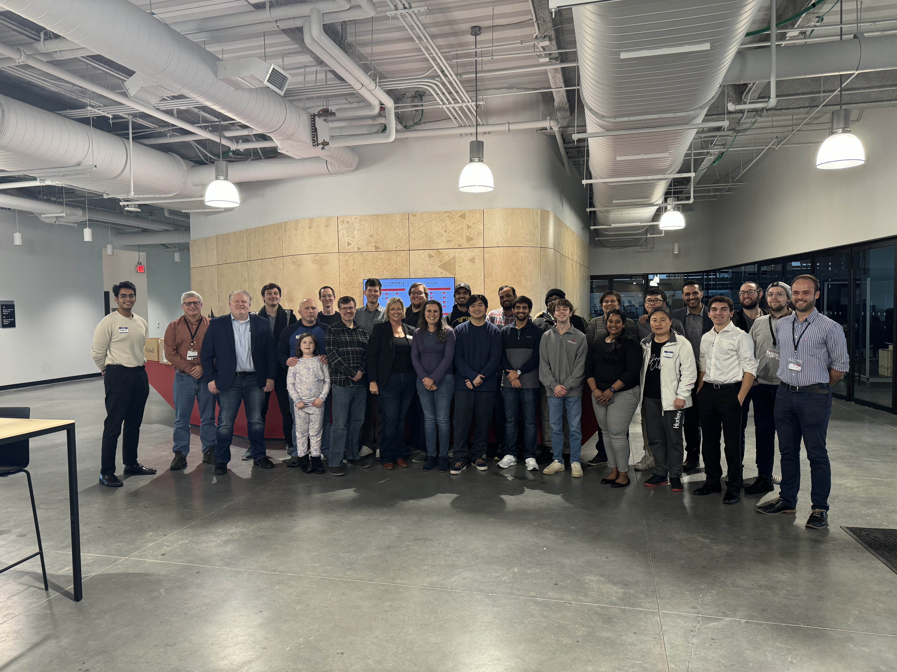
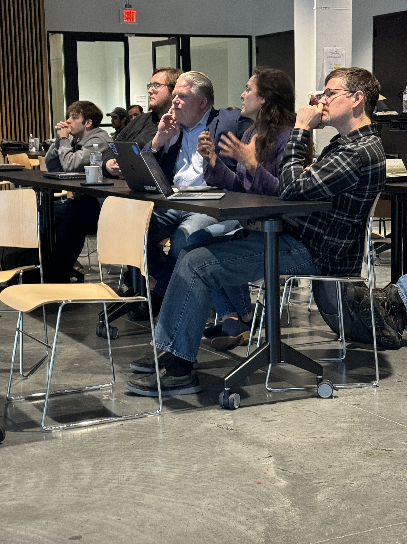
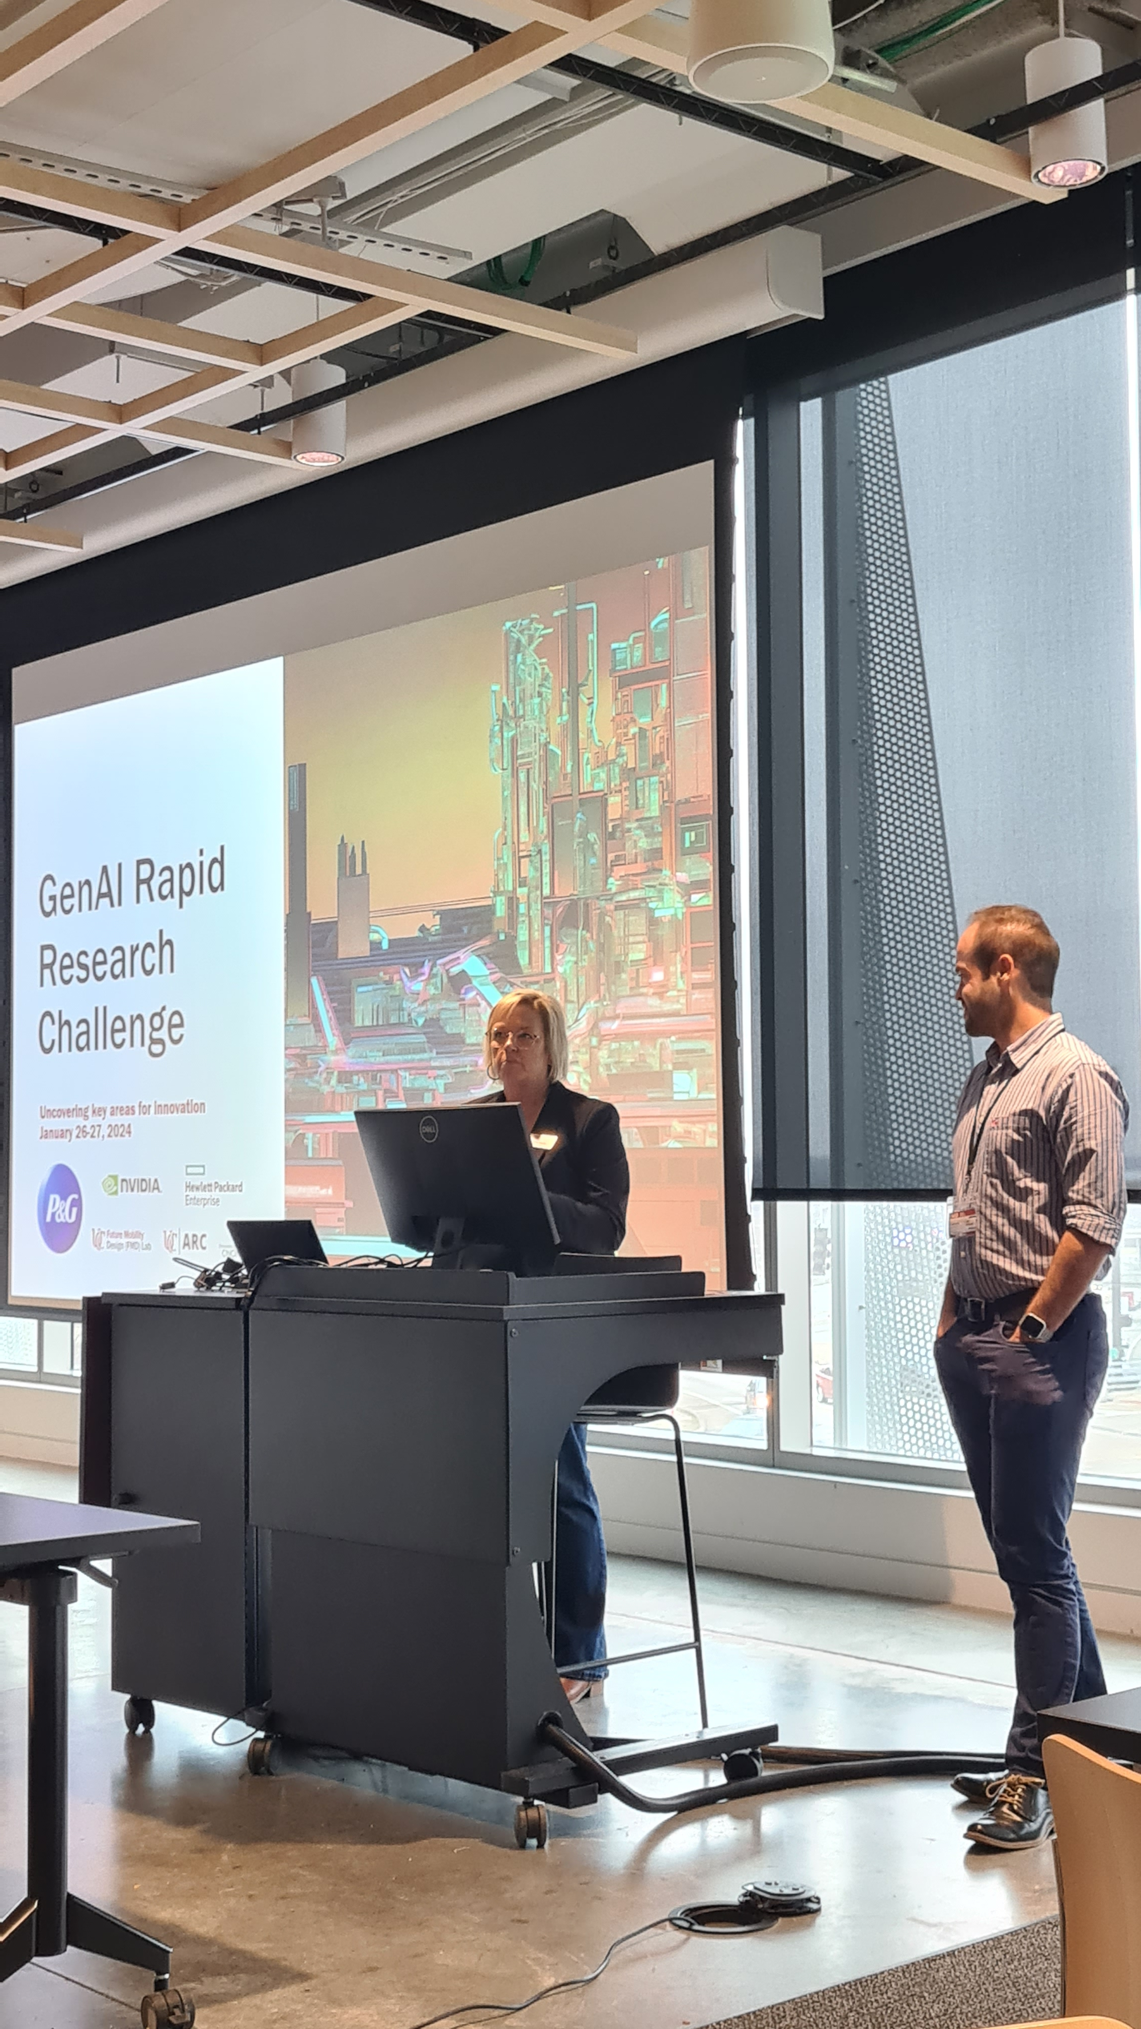
Notes:
The project went stagnant for a few years
Then, in 2024
While at the UC Office of Research
Hosted an event with Procter & Gamble
students used open source LLMs for text classification tasks developed by P&G
I was a student facilitator

Slide 5
ORIENTING CONCEPTS
Notes:
Event was a success
This event got me thinking of ways to apply what we did to our previous work
A few ideas really stuck with me from the event
And I condensed these into 3 main concepts:

Slide 6
ORIENTING CONCEPTS
LLMs are nondeterministic
Outputs are probabilistic
What response is the “true” response?
Must consider a set/distribution for each response
i.e., 1 coding unit = multiple response for the same text
Notes:
The first was that large language models are nondeterministic
Meaning their outputs are probabilistic
If this is the case, how can we know what the “true” response is?
In order to to do that we would need to collect and analyze the distributions of each response
That is to say, one coding unit would be a sampling of multiple sentiment responses to a single text

Slide 7
ORIENTING CONCEPTS
LLMs are nondeterministic
Outputs are probabilistic
What response is the “true” response?
Must consider a set/distribution for each response
i.e., 1 coding unit = multiple response for the same text
MULTISETS
Notes:
And in fact,
In the case of sentiment response these would actually be considered to be what are known as “multisets”

Slide 8
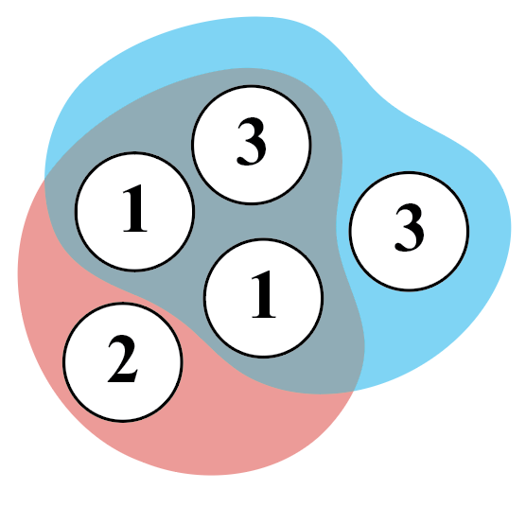
ORIENTING CONCEPTS
W. D. Blizard, “Multiset theory,” Notre Dame J. Formal Log., vol. 30, 1989.
——, “The development of multiset theory,” Mod. Log., vol. 1, pp. 319–352, 1991. [Online]. Available: https://api.semanticscholar.org/CorpusID:117293167
J. L. Hickman, “A note on the concept of multiset,” Bull. Aust. Math. Soc., vol. 22, pp. 211 – 217, 1980. [Online]. Available: https://api.semanticscholar.org/CorpusID:121347325
G. Lamperti et al., “On multisets in database systems,” in Multiset Processing, C. S. Calude et al., Eds. Berlin, Heidelberg: Springer Berlin Heidelberg, 2001, pp. 147–215.
J. Leskovec et al., Mining of Massive Datasets, 2nd ed. Cambridge University Press, 2014.
R. E. Carhart et al., “Atom pairs as molecular features in structure-activity studies: definition and applications,” J. Chem. Inf. Comput. Sci., vol. 25, pp. 64–73, 1985. [Online]. Available: https://doi.org/10.1021/ci00046a002
Notes:
Multisets are important in various domains like biology and computer science
they are like sets but can contain repeating values and are unordered
And they have implementations of normal set functions like difference, intersection, and so on.

Slide 9
ORIENTING CONCEPTS
2. Stateless LLMs
i.e., Open LLMs
Deployed and programmatically (i.e., Python)
(can be) stateless
i.e., no information shared between instances
LLM instance = different coder
Notes:
The second concept was the ability for us to statelessly use large language models
In particular, I am talking about open source LLMs
Which can be deployed programmatically through Python
This means we can spin up multiple LLMs without shared information between them
And we can in essence treat each LLM as a different coder

Slide 10
ORIENTING CONCEPTS
3. Intercoder disagreement
adjudication should be avoided (Krippendorff 2019)
no averaging, no voting, consensus, etc.
Abandon coding project
OR
analyze “multi-value coding”
(Krippendorff 2019 , Krippendorff & Craggs 2016, …)
Notes:
The final concept came after some deep reading of Klaus Krippendorff
And validated some of my frustration with the intercoder analysis done in our previous work
Krippendorff warns us that intercoder adjudication should always be avoided
That is, there should be no averaging or consensus performed in dealing with coder disagreement
So if there is too much disagreement we should abandon the coding project and start over
OR We could try and analyze it through what Krippendorff calls “multi-value coding”
And while there has been some work in this domain going back to the early 2000s, at the time of this study I couldn’t identify any involving LLMs

Slide 11
RESEARCH QUESTIONS

Slide 12
RESEARCH QUESTIONS
RQ1: How internally consistent are LLM coders with respect to their multiset responses to COVID-19 mask-wearing sentiment (reliability)?
RQ2: How do LLM and human coders demonstrate agreement with respect to their multiset responses to these data (validity)?
RQ3: What are the implications of using ”inter-inter- coder” analysis methods of LLM coders in real-time public safety analytics tools?
Notes:
This lead to our research questions exploring reliability and validity in our technique and its applications in public safety

Slide 13
METHODOLOGY

Slide 14



Notes:
We did this work on the University of Cincinnati’s high performance computing cluster (the ARC) using the Ohio Supercomputing Center’s Open OnDemand HPC front end software stack

Slide 15
METHODOLOGY
NVIDIA A100 GPU 40Gb RAM
Linux Debian 12 OS
Ollama server
Jupyter notebook
Python 3.11
Notes:
Using this hardware and and software

Slide 16
METHODOLOGY
llama3 70b
phi3 14b
mistral 7b
gemma2 27b
Notes:
And we selected the following LLM models to cover a range of complexity and parameter sizes

Slide 17
METHODOLOGY
Prompt Engineering
Avoid biasing the model
Kept iteration to a minimum
Tested on a “dummy” prompt to ensure formatting
Notes:
We were very careful while developing our system prompts
Asking coders to return positive, negative, neutral, or uncertain sentiment towards mask wearing
Kept iteration to a minimum so as to avoid injecting bias into the responses
Main focus was returning the correct response format

Slide 18
METHODOLOGY
Prompt Engineering
Avoid biasing the model
Kept iteration to a minimum
Tested on a “dummy” prompt to ensure formatting
Used same prompt for human coders
Notes:
And we made sure to use the exact same prompt for our human coders

Slide 19
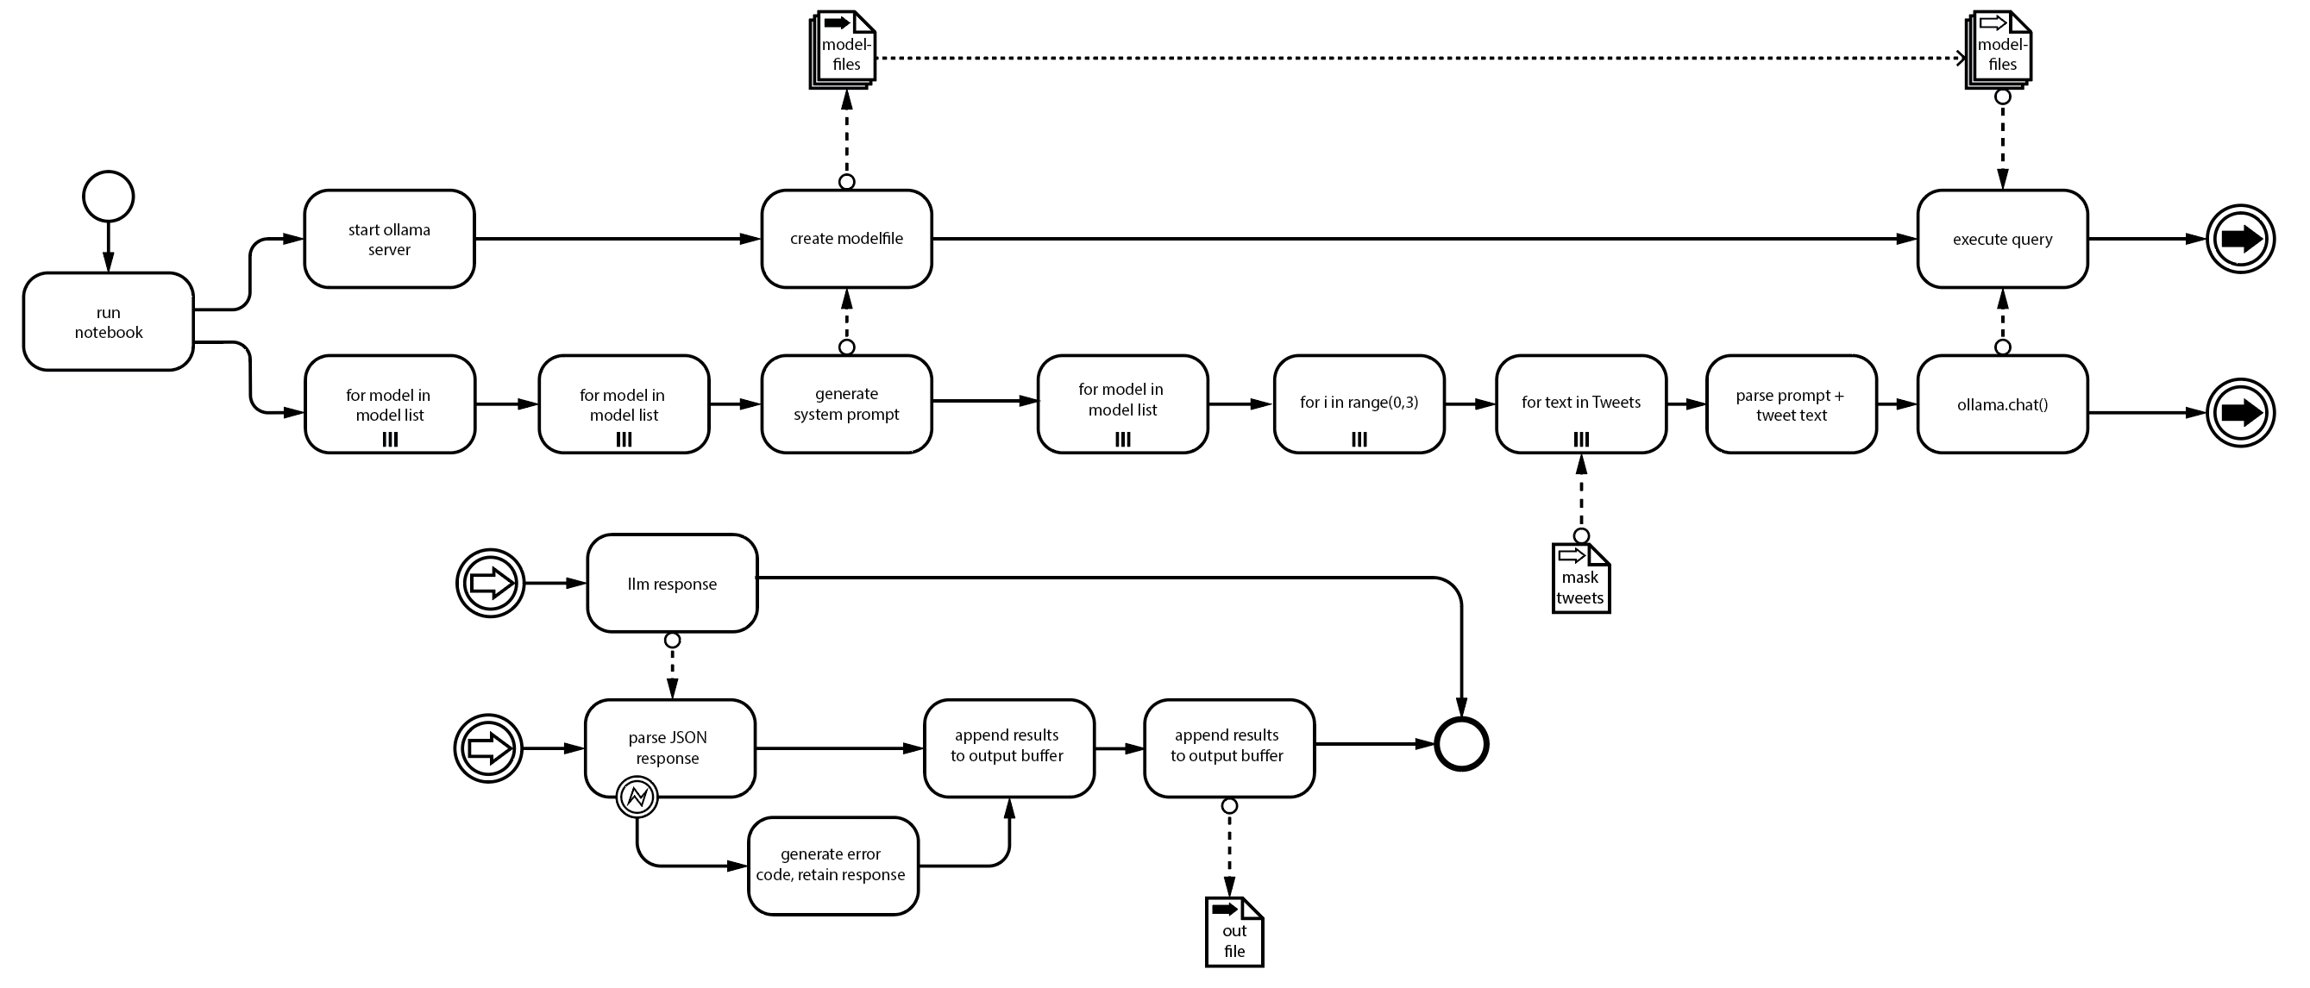
Notes:
All of this is to show that we
Iterated through each of the four models
Across 2000+ tweet texts
Performed sentiment analysis 4 times per text
From this we obtained a sample of 229 well-formed (JSON) responses which we then gave to the human coders

Slide 20
METHODOLOGY
Reliability/Consistency
Notes:
First we looked at reliability and consistency

Slide 21
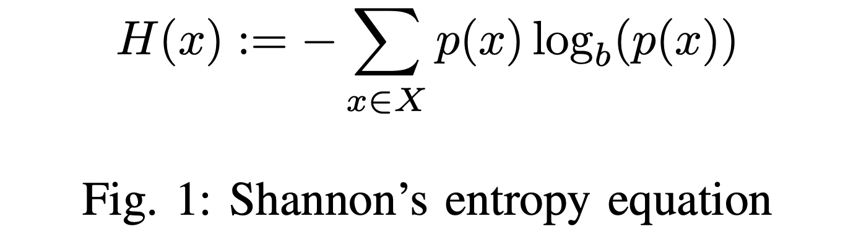
Notes:
We used Shannon entropy as a measure to check reliability on a per-response basis
Shannon’s calculation returns a value 0-1, with 0 being complete consistency and 1 being completely random

Slide 22
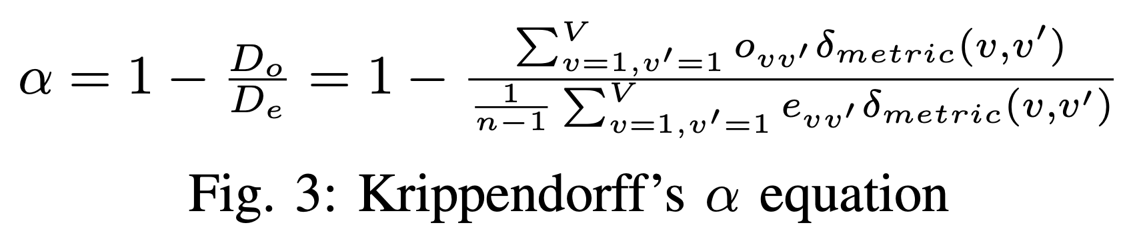
Notes:
We also used a standard Krippendorff alpha calculation to measure within-model agreement
This compares observed and expected agreement between coders
Also returning a coefficient between 0-1
(negative values are possible for structured disagreement)
Should be noted that this measures deviation from perfect agreement
Krippendorff recommends absolute minimum threshold of .67
Though much higher is desired

Slide 23
METHODOLOGY
Validity
Notes:
We also looked at validity – how well the coders compare to one another

Slide 24
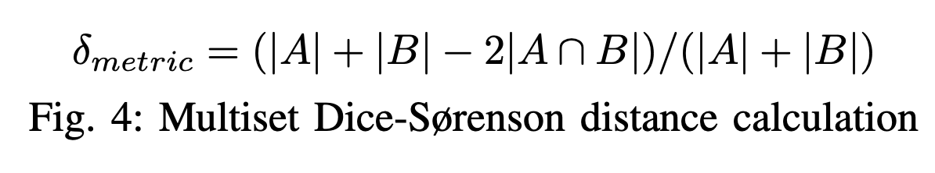
Notes:
For this we use a multiset Dice-Sørenson coefficient
measures the amount of overlap or intersection between two response multisets
…and, in what we believe to be a novel application, we plug this calculation into Krippendorff’s formula to perform what we call “inter-inter-coder” analysis

Slide 25
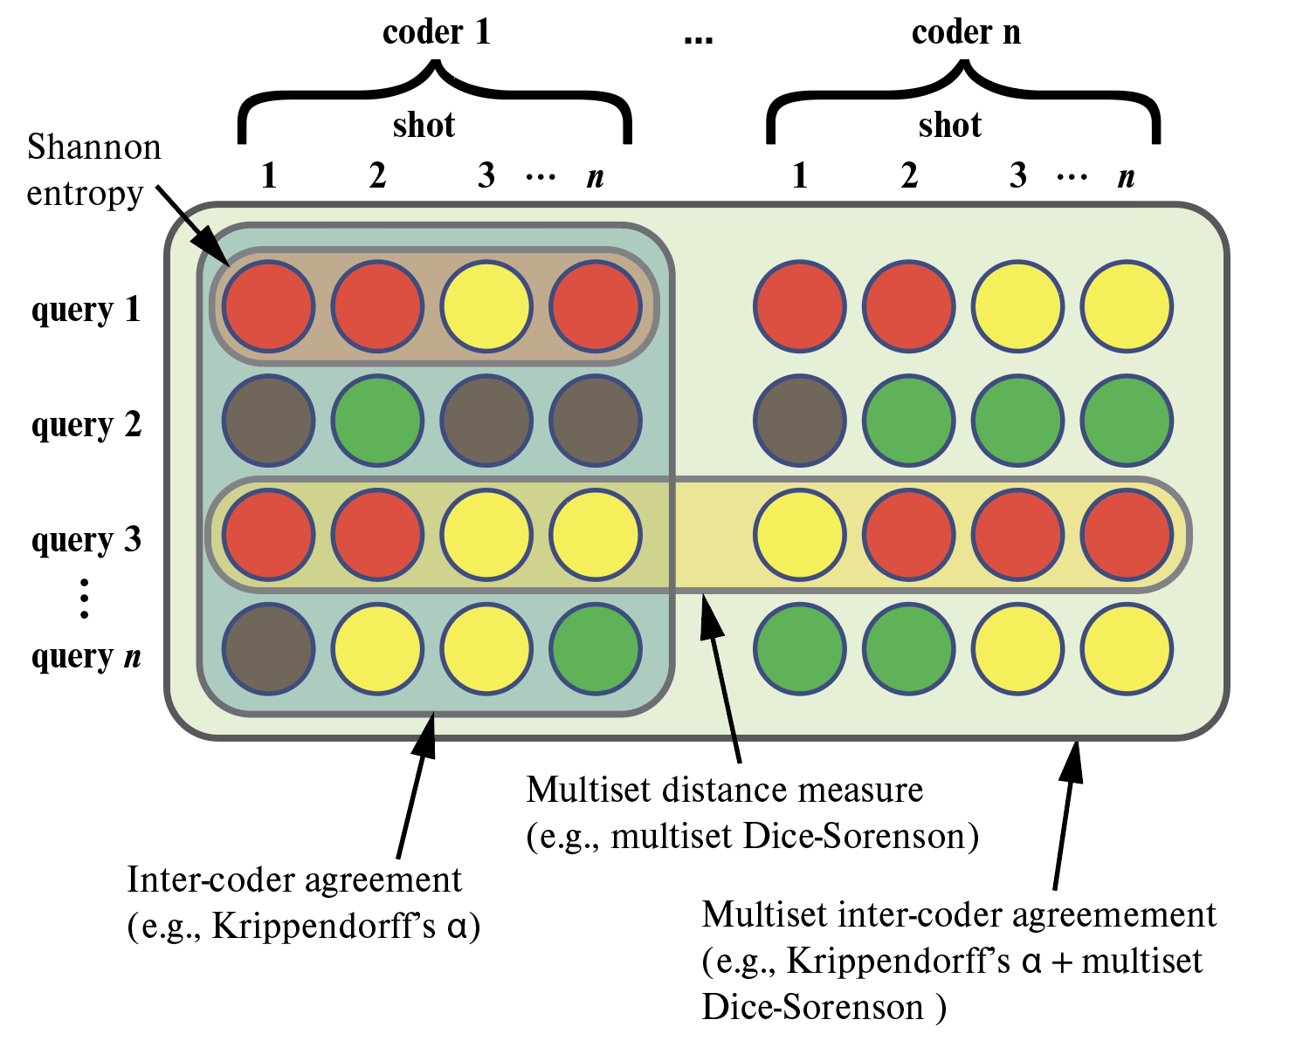
Notes:
In the end, this is how it all comes together
we move from individual responses up through their multisets and between entire coder response multisets
This allows us to compare multiple responses for each text, for each coder, without sacrificing the underlying distributions

Slide 26
RESULTS
Notes:
What were the results?
Analyses were performed using Wolfram Mathematica

Slide 27
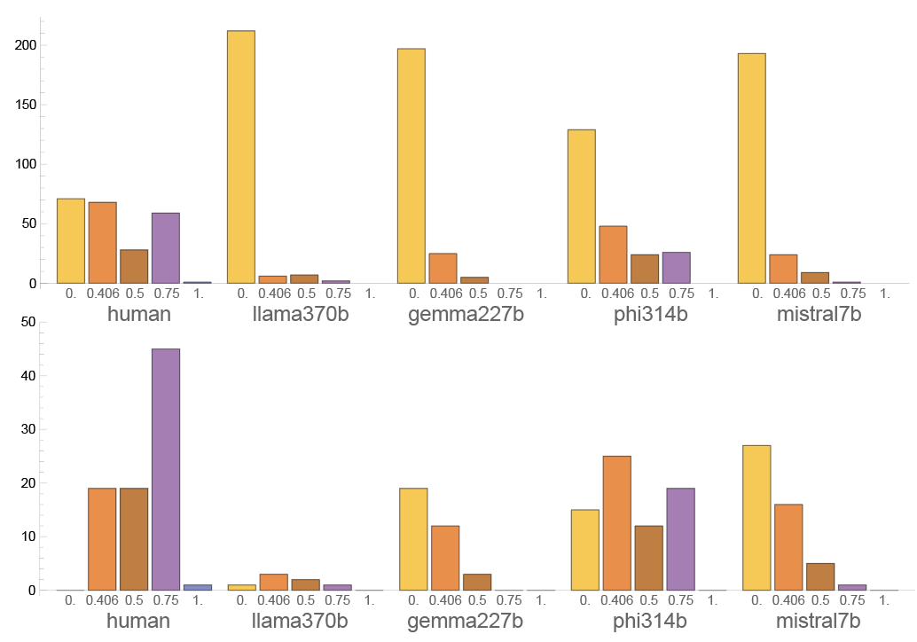
Entropies
Notes:
With regard to the entropy distributions
Found significant differences using nonparametric Mann-Whitney tests
Humans were by far the least consistent – meaning they had the highest amount of overall entropy in their responses
Upper image is entropy for all responses, while the lower contains entropies only for response sets with one or more “uncertain” responses
Basically looking at how uncertain coders were in identifying their uncertainty
Not only were humans the least consistent, but also the least consistent in identifying their own uncertainty as well

Slide 28
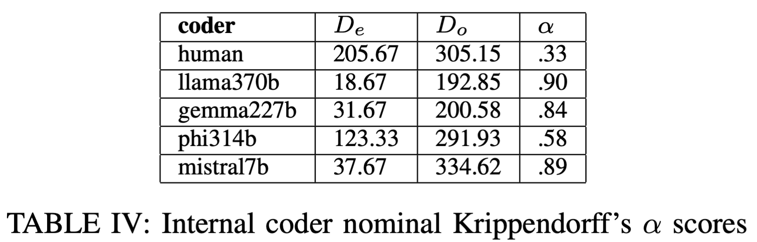

Krippendorff’s $α$
Notes:
Llama, mistral and gemma had high internal consistency/reliability using Krippendorff’s alpha
Humans had low internal consistsency

Slide 29
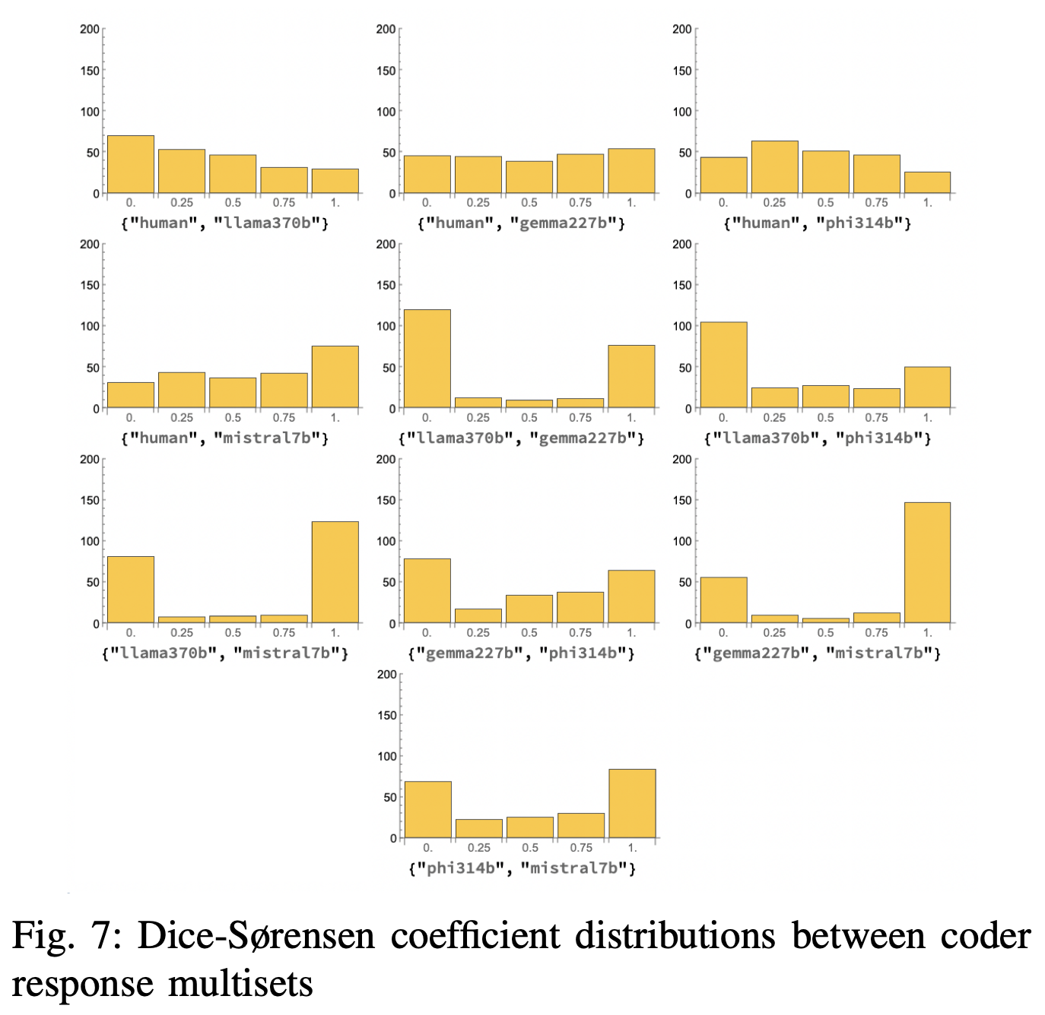
Muliset Dice-Sørenson
Notes:
These are the distributions of the response multiset agreement intersections model-to-model
We can see that some are more or less flat, while other tend towards bifurcation

Slide 30
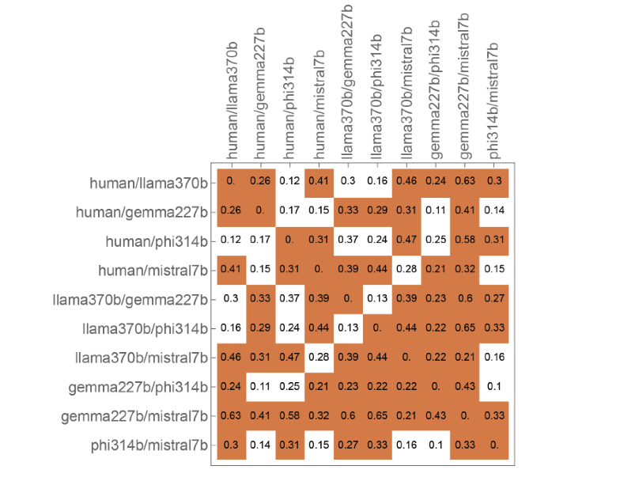
Muliset Dice-Sørenson
Notes:
Here we compare the shapes and locations of these distributions
using Dunn nonparametric post tests and Wasserstein Earth moving distances

Slide 31
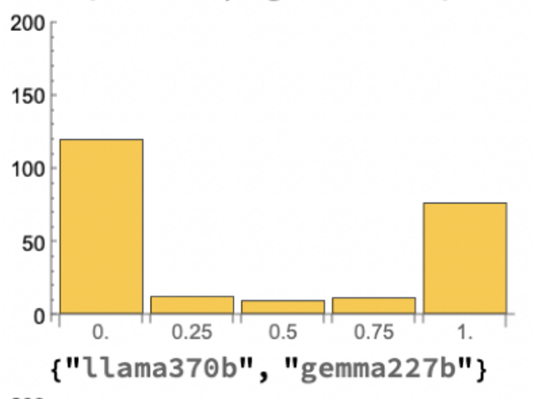
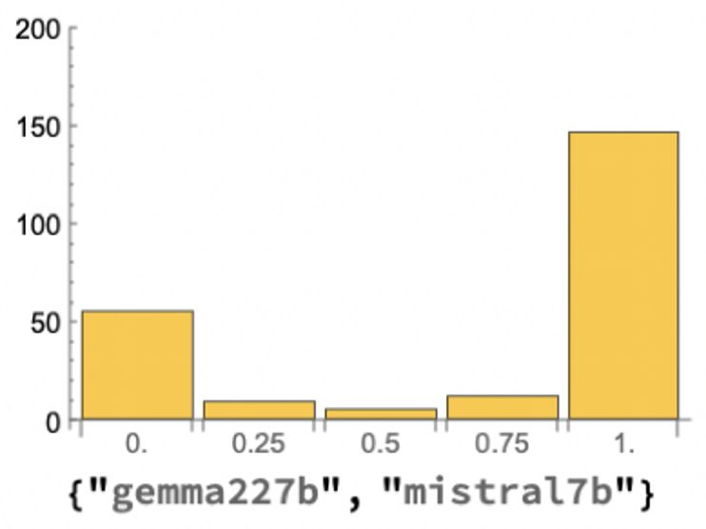
Muliset Dice-Sørenson
Notes:
As an example, if we compare how gemma differs from llama and mistral with regard to multiset intersection
We see they had not only significantly different medians
But they also differed very significantly in the shapes of their distributions,
In other words, they differ in the “style” of their disagreement

Slide 32
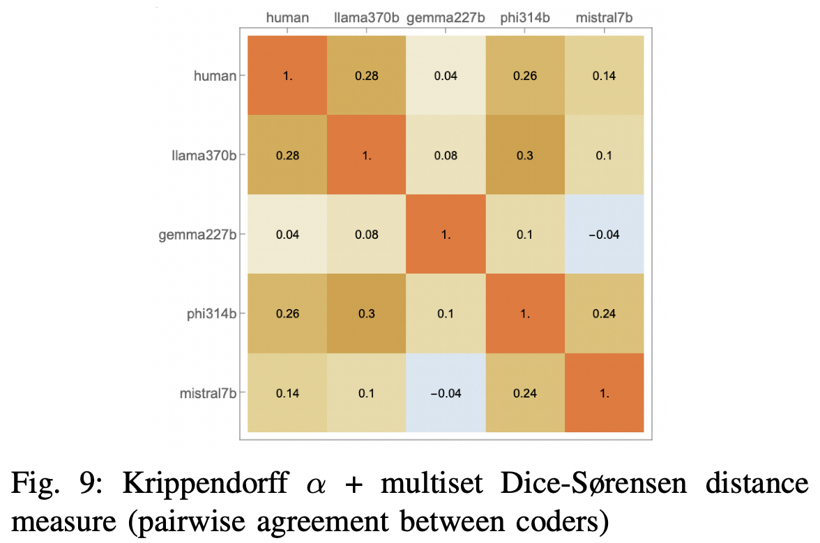

Krippendorff’s $α$ + Multiset Dice-Sørenson
Notes:
Finally we performed the Krippendorff analysis pairwise using the multiset Dice-Sørensen coefficient as a distance measure
Llama and phi had the highest agreement
Gemma and mistral had the lowest (actually, negative) agreement
None had significant agreement (according to the .67 threshold)
And there was a low overall agreement (alpha = .18)
Still interesting that the second highest amount of agreement was between Llama and human coders
Which would not have been obvious just looking at their response data and consistencies

Slide 33
CONCLUSIONS
Notes:
What does this all mean?

Slide 34
CONCLUSIONS
RQ1: Reliability: LLMs tend to be internally consistent with regard to COVID mask-wearing sentiment, human coders inconsistent
RQ2: Validity: very little agreement between any coder set
Notes:
With regard to our first research question (reliability), we found that LLMs tend to be internally consistent and human coders inconsistent
As to the second (validity), there was low agreement between all coder sentiment

Slide 35
CONCLUSIONS
RQ3: “Inter-inter-coder” analysis produces multiple dimensions of reliability and validity for public safety professionals
Notes:
With regard to RQ3 “What are the implications of using our method in real-time public safety analytics?”,
We believe we demonstrated that our technique produces multiple dimensions of reliability and validity for public safety professionals
Technique is generalizable and not limited to sentiment analysis as we used in this the current context
And with the proper implementation, this method has the ability to enhance real-time and near-real time data analysis for public safety professionals

Slide 36
CONCLUSIONS
More broadly:
First application of this method to LLM analysis
First principles: only “real” way to evaluate LLM responses
Notes:
More broadly
As far as we can tell, at the time of the writing this is the first application of this type of method to LLM analysis
And from a first principles perspective, we consider it the only way to ascertain how an LLM is “really” responding
While in this case did not indicate any similarity with human coders
Any similarity would certainly have been missed not using a set- or multiset-based intercoder analysis strategy

Slide 37
LIMITATIONS/FUTURE WORK

Slide 38
LIMITATIONS
Must have sufficient HPC access
Small response distribution (n=4)
Limitations of human coders?
Final tweet set restricted by what was correctly parsed by LLMs
Notes:
There were some limitations to this study. For example,
To perform this type of work, supercomputing resources are required.
Commercial HPC can get expensive
Luckily, academic HPC is widely available and generally affordable
Second, we only collected 4 response samples per response per model
This study was our first effort but we could certainly up the sample size
Do a more robust sampling of coder responses
However the limitations of human coders is a real bottleneck
In particular with regard to the number of available coders
and the length of the datasets they would be wiling to code
Finally the tweets under study were limited by the LLMs’ ability to correctly parse them
Which may be correlated to some underlying factor

Slide 39
FUTURE WORK
More response samples?
Different models/packages/prompt tools
Different analytics/distance metrics?
Multi-agent applications?
Notes:
Again this is our first effort. Open LLM tools are proliferating like crazy and there are countless ways we would expand on this work.
We could not only collect more responses, but we could use different models, model management packages like VLLM, and prompting packages like OpenAI’s Harmony
In other applications we might try different set or multiset analytics and metrics
Even employ multi-agent LLM applications

Slide 40

THANK YOU!
Notes:
Thank you for your time
Files and data used in this study can be found by following this QR code
Including Jupyter and Wolfram notebooks, coder data, etc.

Slide 41
QUESTIONS?
Notes:
I’d be happy to hear any feedback or take any questions

